Slide 2
Overview
Our Work to Date
The State of New Mexico’s workforce challenges are experienced across State agencies. Given today’s talent crunch, New Mexico is exploring ways to enhance retention along with addressing the challenges around recruiting and hiring.
A1: Personnel Act Review
A2: Process Review
A4: Market Competitive Analysis
A5: Job Classification Review
A7: Stakeholder Engagement & Employee Survey
2

Slide 3
A1: Personnel Act Review
Personnel Act Review
Deloitte enhanced New Mexico’s Personnel Act to meet the demands of modern HR practices and improve state governance.
New Mexico’s Current State
Opportunities for Enhancement
Recruitment and Selection:
Applicant Evaluation Process | ◑
Eligible Candidate Selection List | ◑
Expedited Recruitment | ◔
DI&A | ◑
Classification:
Establishment of Classification System | ◑
Audit of Classification System | ◔
New & Revised Classifications | ◑
Compensation:
Compensation Philosophy & Plan | ◑
Compensation Surveys | ◑
Recruitment and Selection
Classification
Compensation
n/a
◔
Basic
◑
Progressing
◕
Advanced
Leading

Slide 4
A2: Process Review
Process Review
Deloitte identified leading practices for the State to improve its recruiting, hiring, and classification processes and the employee experience.
Key Takeaways
Processes & Communication: Lack of transparency & prolonged hiring times
Developed with insights gathered from:
Interviews with 35+ agency and HR professionals providing hiring services statewide
Review of organizational documents including organizational charts, HR policies and procedures, and technology capabilities
Assessment of current state HR operating model, including processes and technologies
Compensation & Agency Budget: High vacancy rates, low morale, & reduced capacity to retain a skilled workforce
Recruiting: Inefficient job advertising, low outreach, & limited external engagement
Policies: Strict minimum qualifications & complex recruitment forms
Career Mobility: Limited mobility & unclear professional development pathways
Technology: Lack of automation & advanced tracking

Slide 5
A2: Process Review
Process Review Continued
Deloitte hosted a Future State Visioning Lab in November 2023 that brought together State Agency HR leaders:
TO ALIGN
on the current state of New Mexico’s recruitment and hiring process
TO BUILD
an operating model that meets the State’s needs
TO COLLABORATE
with each other on ideas that will help enhance the recruiting and hiring process
Our North Star
Be a collaborative and strategic partner that propels agencies forward by helping them attract, retain, and develop talent by providing resources, support, and leveraging technology to improve processes and tools.

Slide 6
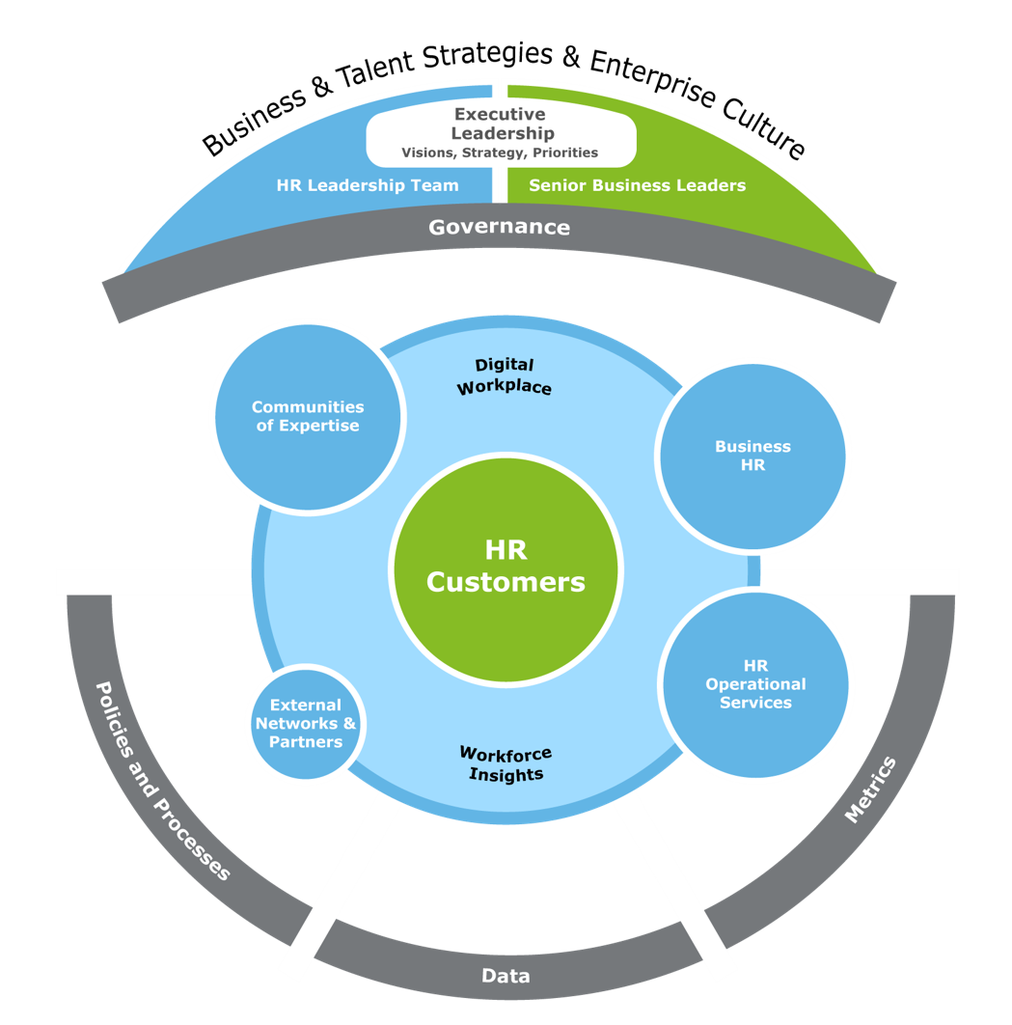
A2: Process Review
Process Review Continued
During the Future State Visioning Lab we also asked the HR leaders to identify a proposed go-forward organizational model to deliver HR services to improve recruiting, hiring, and classification processes and the employee experience.
6
Senior Agency Leaders
Proposed HR Operating Model
7
1
THE AGENCY
EXTERNAL NETWORKS & PARTNERS
2
4
5
Centers of Expertise
2
DIGITAL WORKPLACE
1
HR Strategy
Analysts
3
HR OPERATIONAL SERVICES
6
HR LEADERSHIP
AGENCIES
CENTER OF EXPERTISE (COE)
3
7
HR Operational Services
4
HR STRATEGY
5
Notes
¹ This model does not encompass employees withing the legislative and judicial sectors.
² The Department of Agriculture is fully integrated into our process optimization efforts, although is not reflected in the compensation data.

Slide 7
A4: Market Competitive Analysis
Market Competitive Analysis
Deloitte confirmed the State's benchmarking strategy and analyzed market data for salaries and benefits to ensure competitiveness.
Current Benefit Offerings
Current Compensation Offerings
 | Below Market | At Market | Above Market
Medical | ●
Dental |  | ● | ●
Vision |  | ●
Disability | ●
Life |  | ●
Time Off | ● | ●
Average benchmark position is compensated 10.3% above the government market
Average benchmark position is compensated 4.7% below the general industry market
11 total salary structures with a total of 109 individual pay plans
15%* of employees will have an immediate change to their base compensation
44%* of employees would have a proposed pay grade maximum that is higher than their current maximum
*Out of the 11,451 employees covered by the benchmarking survey.

Slide 8
A4: Market Competitive Analysis
Market Competitive Analysis Continued
Deloitte confirmed the State's benchmarking strategy and analyzed market data for salaries and benefits to ensure competitiveness.
Structure Component | Current State of New Mexico Practice | Proposed Go-forward Approach
Type of Structure Used | Hay methodology | Market-based
Number of Structures | 11, including structures created for specific professions (e.g., Attorneys, IT) | 1, covering all classified positions and employees
Number of Total Pay Grades | 109 | 20
Pay Grade Titles | Mix of numbers and letters | Numbers, starting at 1 and increasing to 20
Pay Grade Width | 30% at the lower range to 60% at the upper | 40% at lower levels increasing to 70% at higher pay grades
Midpoint Differentials | Inconsistent from pay grade to pay grade, between 2.7% to 34.2% | Consistent, ranging from 10% at lower levels to 15% at higher pay grades
Opportunities for Enhancement
Transition to a single salary structure
Implement consistent increases to midpoint differentials
Extend pay grade progression
Re-evaluate benefit offerings to match evolving employee needs

Slide 9
A5: Job Classification Review
Job Classification Review
Deloitte reviewed existing job classifications and optimized the job classification framework to align with New Mexico’s evolving needs and policies of their workforce.
New Mexico’s Current State
Opportunities for Enhancement
Stand up a classification center of expertise
Lack of job categorization
No documented career tracks
Implement a statewide e-workflow tool
Inconsistent job to level/grade alignment
Redesign the state’s job architecture (JA)
Lack of standardization in job titling
Analyze workload for key positions

Slide 10
A7: Stakeholder Engagement & Employee Survey
Stakeholder Engagement & Employee Survey
Deloitte administered a State-wide Employee Engagement Survey to explore drivers of retention and attrition across State agencies.
Top Reasons for…
Participants were asked their level of agreement (Agree, Slightly Agree, and Strongly Agree shown below) to positive statements related to the following themes:
Attrition:
Retention:
Compensation
Lack of flexibility to work remotely
Negative work environment and no sense of belonging
Ability to attain a work/life balance
Benefits
Relationship with manager
Opportunities for Enhancement
Establish unified, state-wide Marketing and Branding Strategy
Evaluate telework options and combine with real estate strategy
Implement onboarding program and build awareness for existing professional development curriculum

Slide 11
Proposed future work
Key Takeaways and Opportunities for New Mexico
Deloitte has identified the following activities the State can undertake to improve its HR operations and enhance the employee experience.
Most Impactful Opportunities
Redesign the State’s Job Architecture
Conduct study to understand employee preferences on Total Rewards
Implement the HR Operating Model developed from Agency HR leaders’ input in the Future State Visioning Session
Establish unified, State-wide marketing and branding strategy
Procure and implement an HR data reporting and digital workflow technology
Evaluate telework options and combine with real estate strategy
Implement onboarding program and build awareness for existing professional development curriculum
Analyze the workload for key positions

